Slide 1

Assessment 1 Weight Loss Method
(Blair) Chuanhui Zheng
Big Fat Myths Gens1111

Slide 2
Description and how the drug works: Describe the drug: when was it discovered, who should use the drug and at what dosage (3 marks)
In 2012, Arena Pharmaceuticals released Lorcaserin as a weight-loss drug. The drug is mainly designed for the obese population, particularly those patients with a Body Mass Index (BMI) of 30 and above. Also, Lorcaserin is recommended for adults who have a BMI of 27 and above if they have one weight-associated health condition like high blood pressure or type 2 diabetes. The dose recommended for using Lorcaserin is 10 mg twice daily. This medication is known to increase serotonin receptors in the brain, increase feelings of fullness, and reduce food intake.

Slide 3
Description and how the drug works: Using an appropriate diagram describe the mechanism of action of this drug (5 marks)
Lorcaserin belongs to the selective serotonin 2C receptor agonists. It acts by selectively triggering the serotonin 2C receptors situated in the hypothalamus, which is a part of the brain that is related to feeding. Namely, by activating these receptors, Lorcaserin elevates the serotonin concentration in the brain, a neurotransmitter that directly affects mood and appetite.
Stimulating 5-HT2C receptors helps to increase the satiety experience, implying that those taking Lorcaserin can consume lesser quantities of food and feel full. This reduces food intake and is thus the primary reason for reducing the body's size, the common terminology known as “weight loss.”

Slide 4
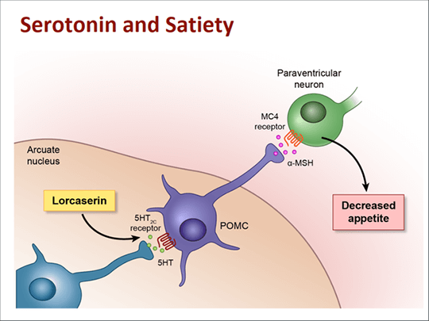

Slide 5

The diagram on the slide above shows Lorcaserin's mechanism of action. Lorcaserin has anxiolytic effects in that it acts at the 5-HT2C receptors located in the hypothalamus and sets off a chain of reactions that cause the release of Serotonin. The elevations in serotonin levels trigger brain stimuli that inform the body that it is satiated, hence the reduced feeding frequency.
This mechanism benefits obesity-related cases by ensuring the tenders do not consume very little food when considering slimming down. However, it is also noteworthy that Lorcaserin is most effective with diet and exercise modification (Mazza et al., 2024). However, this should be done under the close supervision of a healthcare provider to measure its effectiveness and any side effects that can be experienced.

Slide 6
Description and how the drug works: Explain how this mechanism of action leads to weight loss. You must refer to the content from lectures to answer this section (5 marks)
Lorcaserin’s mechanism of action results in a more effective weight loss goal by influencing appetite control. It is a selective agonist of 5-HT2C receptors responsible for appetite, primarily in the Hypothalamus. Lorcaserin acts on these receptors to stimulate serotonin, the neurotransmitter regulating mood and appetite. Higher serotonin degrees make people feel satiated or full, eat less, and fill their stomachs quickly. This process helps suppress hunger and, hence, uses fewer calories.
As noted from Lecture 1, weight loss is tied to a long-term consistent limitation of calorie intake. Thus, with the help of Lorcaserin, patients reduce the volume of food intake and achieve negative balance, which is the primary condition for weight loss. This gradually results in weight loss because the body is in a state of intake that is less than usual for an extended period.

Slide 7

Further, the satiety effect precipitated by serotonin means that an individual can easily stick to a low-calorie diet as they are not likely to be overwhelmed by hunger or food cravings. This makes Lorcaserin beneficial, mainly when used along with exercise, reduced food intake, or even a better diet plan.
Lorcaserin is a weight loss drug; however, its use should be done under prescription to consider the side effects to be cautious of while using it and also to complement other weight loss strategies (Kim et al., 2020). This approach helps to enhance the effect of the drug, as well as reduce the possible side effects for weight loss in people like Amy.

Slide 8
Scientific Studies: Include results of two different scientific studies done to measure the effectiveness of the drug. You must provide sufficient details about the study to understand the study design, methods, findings and what the results mean. The document must also contain screencaps of the journal articles you used as seen below. (8 marks)
Study 1
The article “Lorcaserin (Belviq): A Selective Serotonin 5-HT2C Agonist In the Treatment of Obesity,” authored by Ashley Gustafson, Camille King, and Jose A. Rey, is a randomized, double-blind, placebo-control trial. This design is regarded as the best in clinical research since it reduces bias and guarantees the validity of the results. This work included overweight/obese patients; the study included patients with a BMI greater than 30 or having a BMI of 27 instead and suffering from weight-related comorbidity, including hypertension or type 2 diabetes (Gustafson, King, and Rey, 2013). At the beginning of the study and during 52 weeks, patients were randomized to the group receiving Lorcaserin 10mg two times a day or placebo.

Slide 9
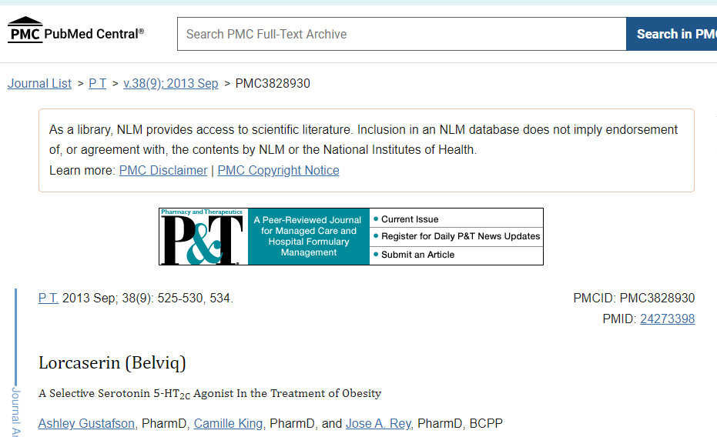

Slide 10
The study's primary outcome was the proportion of weight loss from baseline to week 52. Secondary objectives were altering cardiometabolic intermediate outcomes like blood pressure, fasting blood sugar, insulin concentration, and lipid profile (Gustafson, King, and Rey, 2013). The techniques used made it possible to assess the extent to which Lorcaserin would be helpful not only in the desire for weight loss but in optimizing metabolic health, too.
The outcome of this study was substantial. In the weight loss evaluation, the Lorcaserin group had higher mean reduction values than the placebo group. Specifically, 47.5% of the participants in the Lorcaserin group achieved at least a 5% reduction in their baseline body weight compared to only 20.3% in the placebo group (Gustafson, King, and Rey, 2013). The Lorcaserin group displayed the following benefits in cardiometabolic parameters: decreased blood pressure, fasting glucose, and insulin levels; improved lipid profiles; decreased LDL cholesterol and triglycerides; and increased HDL cholesterol.

Slide 11
The outcome of this study suggests that Lorcaserin has the potential to be a weight loss aid that is beneficial to the cardiometabolic health of overweight and obese patients. The results of the studies in this review support the use of Lorcaserin as a relevant pharmacological intervention in obesity since it helps reduce weight and exhibits beneficial and significant effects on metabolic profile (Gustafson, King, and Rey, 2013). These enhancements can drastically decrease the possibilities of numerous obesity-related illnesses, thus making Lorcaserin effective for patients with weight loss issues.

Slide 12
Scientific Studies: Include results of two different scientific studies done to measure the effectiveness of the drug. You must provide sufficient details about the study to understand the study design, methods, findings and what the results mean. The document must also contain screencaps of the journal articles you used as seen below. (8 marks)
Study 2
The study entitled “Effects of Lorcaserin on Cardiometabolic Risk Factors in Overweight and Obese Patients: A Systematic Review and Meta-Analysis” summarizes several clinical trials to evaluate the effectiveness of Lorcaserin. The study entails a variety of RCTs on the differences in Lorcaserin’s impact on cardiometabolic risk factors in overweight and obese patients (Kuo et al., 2019).

Slide 13
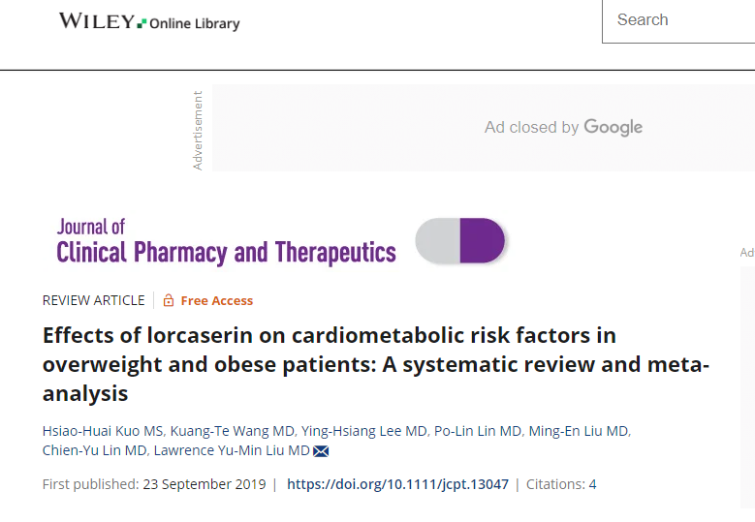

Slide 14
Some of the electronic databases used are PubMed and ClinicalTrials. From these studies, it was evident that the use of Lorcaserin works or helps treat multiple cardiometabolic risks in overweight and obese patients. Lorcaserin, therefore, improves the patient’s cardiac function since it affects systolic and diastolic blood pressure (Kuo et al., 2019). Also, Lorcaserin is beneficial in reducing fasting glucose levels and LDL cholesterol, which are essential markers in managing diabetes and preventing heart disease.
The results also indicated an enhancement in HDL cholesterol. Based on this study, Lorcaserin is helpful in the weight loss process and supports the general enhancement of cardiometabolic health for managing obesity and its risks.

Slide 15
Critique: Potential general side effects associated with the drug? (1 mark)
Lorcaserin efficiently manages weight loss and improves cardiometabolic indices, although it has side effects. Side effects may include headache, dizziness, tiredness, nausea, and dry mouth. Such side effects usually are minor and may subside as the client takes the supplement (Tchang et al., 2019). Nevertheless, the patients should be informed of these possible challenges and consult with the healthcare provider to avoid adverse effects when using Lorcaserin productively. These side effects are usually manageable, for example, by constant monitoring to reduce their impacts on the body's general health.

Slide 16
Critique: Does it lead to or eliminate the risk of specific diseases? (2 marks)
Under different circumstances, Lorcaserin can lower the risk for some diseases primarily by the mechanisms contributing to weight loss and cardiometabolic characteristics. The overall risk of developing type 2 diabetes should also be reduced by Lorcaserin, as weight loss, which is one of the drugs’ effects, makes the body respond more effectively to insulin and regulate glucose levels. Also, changes in blood pressure and lipid profiles indicate a possible decrease in the incidence of cardiovascular diseases (Higgins, Fletcher, and Shanahan, 2020). Thus, it can be concluded that there is little to no data that proves that Lorcaserin decreases the risk of cancer. To enhance these benefits, one has to attend check-ups frequently and make numerous changes in one’s lifestyle.

Slide 17
Critique: Does the drug allow you to get all the necessary nutrients. (2 marks)
Lorcaserin does not prevent the body from absorbing essential nutrients from the foods that one takes. Its main aim is to suppress hunger, thus equating to a minimum amount of food energy intake. Nevertheless, it becomes easy for users to pay attention to some vitamins and minerals they need in their meals, so it is wise to recommend that users eat balanced, nutritious meals (Singh and Singh, 2020). Therefore, it is advisable to take foods rich in these nutrients to counteract any risk of nutrient scarcity. Hence, as for weight loss, Lorcaserin is hugely beneficial for a well-rounded diet.

Slide 18
Critique: Sustainability of using the drug long term and whether the weight loss will remain once you stop taking the drug? (2 marks)
The long-term use of Lorcaserin serves under the critical condition of consistent medical supervision to monitor side effects and ensure safety. Based on utility, Lorcaserin is potent in causing weight loss, although there is a tendency for a patient to regain the lost weight as soon as they stop taking the drug. This is because the main dieting behaviors cause weight gain and metabolic alteration (Tak and Lee, 2021). While on Lorcaserin and after its use to lose some pounds, patients should maintain those results by altering their lifestyle and daily habits to include proper meal intake and exercise.

Slide 19
Conclusion: Would you recommend Amy use this drug? Give reasons as to why you came to this conclusion. You should also use Amy's stats to help support your conclusion (5 marks)
Considering all the researched evidence, I would recommend Amy take Lorcaserin to manage her weight. First, it is necessary to note that Lorcaserin has been established to help people lose weight. Experts found that many patients shed substantial weight from the drug; almost half of the patients in clinical trials lost at least 5 percent of their initial body weight. This is very true for Amy, who is obese, which comes with many health risks for her.
Second, Lorcaserin has beneficial effects on patients' cardiometabolic risk profiles. The study upheld reductions in blood pressure, fasting glucose, and LDL cholesterol, which are conducive for Amy, given her risk factors for cardiovascular diseases and diabetes. These improvements can significantly reduce her chances of developing other severe health complications.

Slide 20

Furthermore, Lorcaserin can be taken over the long term because it is safe without a prescription. Nonetheless, there are some side effects of using these drugs; however, most of the effects are mild and can easily be controlled. These side effects can be significantly minimized, however, if Amy is to consult a healthcare provider for a routine check-up using the drug.
Amy’s BMI is relatively high, accompanied by the corresponding health issues; therefore, she fits the Lorcaserin prescription. By combining the above medication with diet changes, such as balanced diets and physical activities like walking, Amy can lose plenty of weight and avoid regaining it. Hence, as an informed practitioner, I find Lorcaserin a valid treatment strategy for Amy’s weight loss plan.

Slide 21

Reference List (2 marks)
Gustafson, A., King, C. and Rey, J.A. (2013) Lorcaserin (Belviq): a selective serotonin 5-HT2C agonist in treating obesity. https://www.ncbi.nlm.nih.gov/pmc/articles/PMC3828930/.
Higgins, G.A., Fletcher, P.J. and Shanahan, W.R. (2020) 'Lorcaserin: A review of its preclinical and clinical pharmacology and therapeutic potential,' Pharmacology & Therapeutics, 205, p. 107417. https://doi.org/10.1016/j.pharmthera.2019.107417.
Kim, B.-Y. et al. (2020) 'Current Long-Term Pharmacotherapies for the Management of Obesity,' Journal of Obesity & Metabolic Syndrome, 29(2), pp. 99–109. https://doi.org/10.7570/jomes20010.
Kuo, H. et al. (2019) 'Effects of lorcaserin on cardiometabolic risk factors in overweight and obese patients: A systematic review and meta‐analysis,' Journal of Clinical Pharmacy and Therapeutics, 45(1), pp. 35–44. https://doi.org/10.1111/jcpt.13047.

Slide 22

Mazza, M. et al. (2024) 'Lorcaserin: Worthy of Further Insights? Results from Recent Research,' CNS & Neurological Disorders. Drug Targets, 23(3), pp. 278–283. https://doi.org/10.2174/1871527322666230330124137.
Singh, A.K. and Singh, R. (2020) 'Efficacy and safety of lorcaserin in obesity: a systematic review and meta-analysis of randomized controlled trials,' Expert Review of Clinical Pharmacology, 13(2), pp. 183–190. https://doi.org/10.1080/17512433.2020.1703109.
Tak, Y.J. and Lee, S.Y. (2021) 'Anti-Obesity Drugs: Long-Term Efficacy and Safety: An Updated review,' the World Journal of Men’s Health, 39(2), p. 208. https://doi.org/10.5534/wjmh.200010.
Tchang, B.G. et al. (2019) 'An up-to-date evaluation of lorcaserin hydrochloride for the treatment of obesity,' Expert Opinion on Pharmacotherapy, 21(1), pp. 21–28. https://doi.org/10.1080/14656566.2019.1685496.

Slide 23

Assessment Completion Process: B
Why did you decide not to use AI to complete this assessment task? I wanted to challenge myself and enhance my research and critical thinking skills. Moreover, excessive use of AI may disrupt my original thinking. The greater dependence on AI will lead to a lack of self-created content.
What was your process for researching and completing this assessment task? I used academic databases, peer-reviewed journals, and textbooks to gather relevant information and synthesize the data into my assessment.
Have you ever used AI to complete assessment tasks? If so, which tools were the most helpful and why? No, I have not yet used AI tools.
Do you worry that relying on AI tools now might negatively impact your ability to learn independently in the future? Yes, over-reliance on AI tools could potentially diminish my critical thinking and problem-solving skills. Playing into the role of researching is very important.

Slide 24

How can educators better support you in using AI tools effectively for your learning? Educators can provide guidelines on ethical AI use, integrate AI literacy into the curriculum, and encourage balanced use alongside traditional learning methods.
If a tutor were to quiz you on the content of this assessment task in person how confident are you in being able to answer their questions? Would the confidence level change if you used AI to complete the assessment? I am confident in my understanding of the assessment content, but my confidence would still be up since I would only use AI as a research tool.

Slide 25

Thank you

